Slide 1
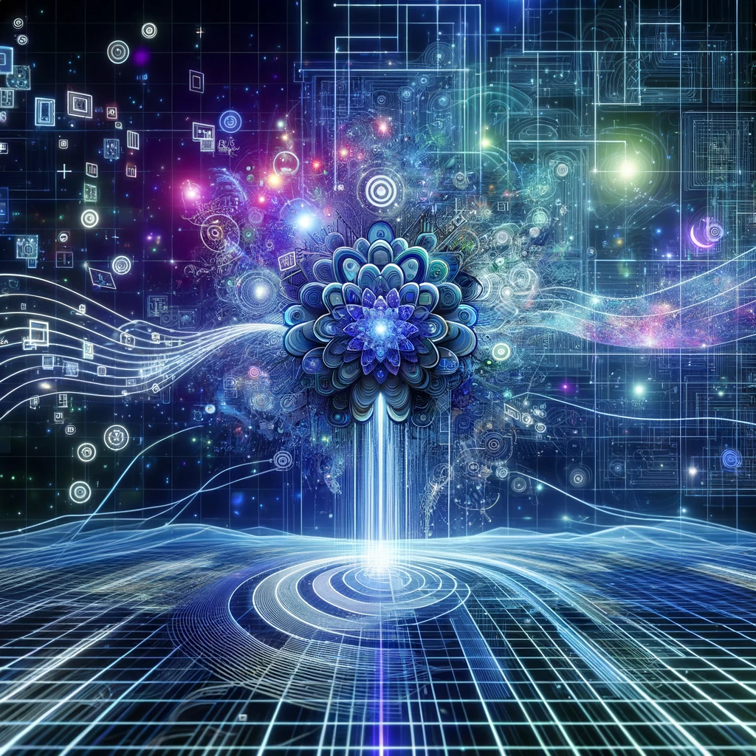
From Chaos to Clarity: Latent Diffusion Assignment 8: A Deep Dive into Latent Diffusion with CLIP, VAE, UNet
Devesh Surve
27th March 2024
ID: 002766974

Slide 2
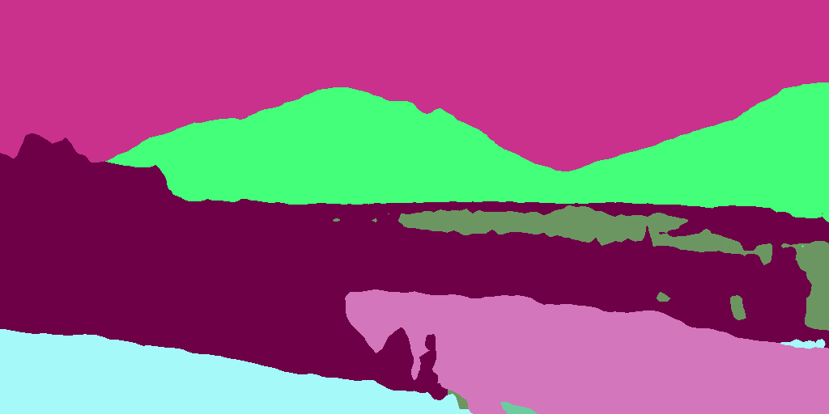
What are LDMs (Latent Diffusion Models) ?
DPMs (Diffusion Probabilistic Models):
Achieve state-of-the-art results in text to image synthesis and beyond.
Issue : Require significant computational resources
Introduction of LDMs (Latent Diffusion Models):
Operate in the latent space of pre-trained autoencoders
Address the computational challenges of traditional DPMs
Two Phases of Training:
Perceptual Image Compression: pretrained autoencoders encode images into a latent space
Latent Diffusion: Sequential denoising and refining steps in the latent space, utilizing cross-attention layers to achieve high-quality synthesis.
Outcomes and Efficiency:
Set new standards for image inpainting
Significantly reduce the computational requirements

Slide 3
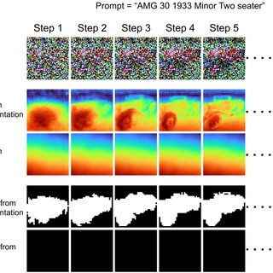
Role of VAEs (Variational Autoencoders ) ?
VAE Structure and Function:
Consists of two main components:
Encoder E
Decoder D.
Encoder E:X→Z that maps high-dim input data X to a low-dim latent space Z.
How ? By minimizing reconstruction loss + regularizing term ensuring normal distribution
Decoder, D:Z→X that aims to get original image from the latent representation
Role in Perceptual Compression:
Encoder part of the VAE compresses input images into a latent representation.
Process is termed "perceptual compression" because it aims to preserve human perceptually relevant information
Achieved through a balance in the VAE loss function of following :
The fidelity of reconstruction (ensuring that decoded images still resemble the original ones)
Regularization of the latent space (ensuring that the space is smooth and well-organized).
Integration with LDMs: Once images are compressed into the latent space by the VAE, LDMs then operate within this reduced-dimensional space

Slide 4
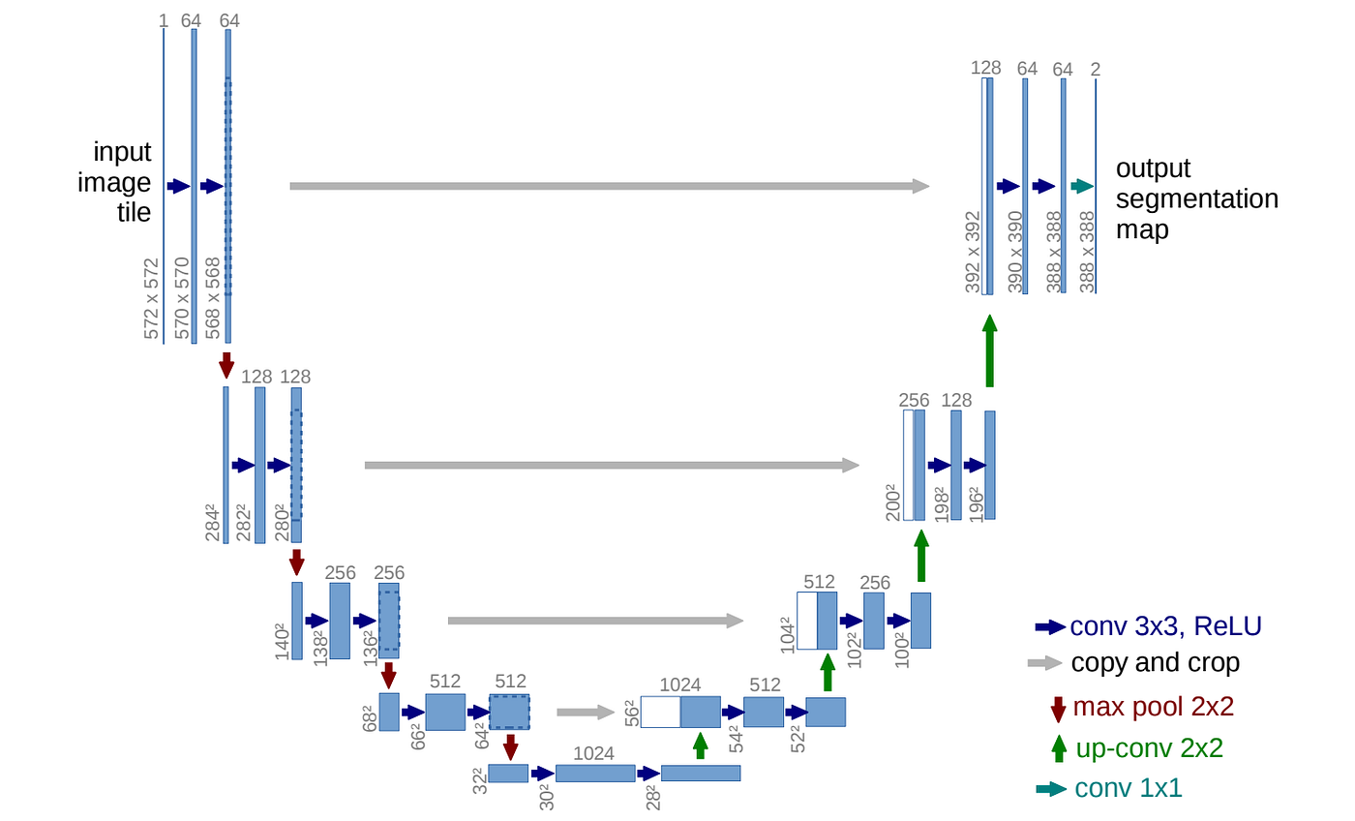
No Diffusion without “U”(nets :)
U-Net Architecture:
CNN Architecture serves as a core LDM component for denoising
Captures context and reduces dimensionality through convolution and pooling layers
Role in LDMs:
Adapted to work with latent representations rather than raw pixel data.
Receives a noisy latent version of an image (or another data type)
Incrementally denoises it through the diffusion process.
Each layer of the U-Net is tasked with understanding different scales of noise and detail,
Denoising Process:
Reverse the noise addition process to predict the clean version of the current noisy image at each step of the reverse diffusion process.
Involves estimating the subtraction of noise from the current state, for loss function based on difference b/w the U-Net's output & original image
Speciality - Skip Connections for Context Preservation:
Allow the model to carry detailed information directly from the contracting path to the expanding path, helping preserve context
Integration with VAE’s Latent Space Modeling:
U-Net operates within the compressed, efficient space created by a VAE

Slide 5
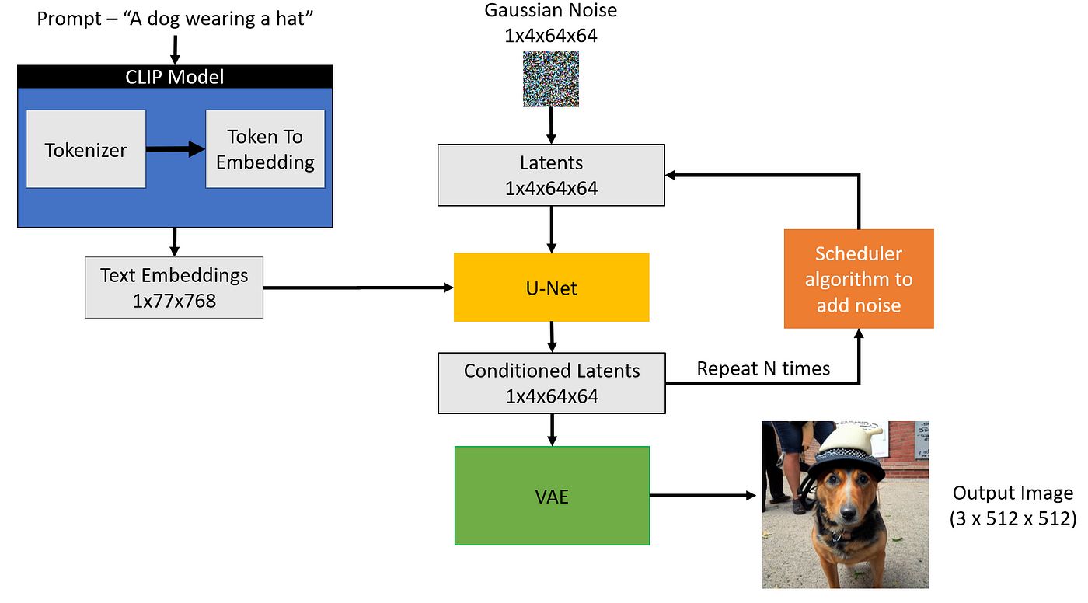
Enhancing LDMs with CLIP
CLIP Integration in LDMs:
CLIP (Contrastive Language–Image Pre-training)
integrates with Latent Diffusion Models (LDMs) to bridge textual and visual data.
Role in Text-to-Image Synthesis:
Enables LDMs to generate images that closely align with natural language descriptions.
Facilitates a direct translation of textual concepts into detailed, corresponding visual representations within the latent space.
Semantic Guidance and Conditioning:
Offers semantic understanding to LDMs, guiding the generation process to ensure output images match textual prompts accurately.
Acts as a semantic filter, ensuring that generated images adhere to the conceptual expectations set by input text.
Interfacing with Latent Representations:
Works alongside the encoding and decoding processes of LDMs to maintain consistency between textual prompts and generated images.
Enhances the latent space with linguistic context, allowing for more targeted and expressive image generation.
Enhanced Content Creation:
By incorporating CLIP, LDMs can produce more varied, contextually relevant, and semantically rich visual content.

Slide 6
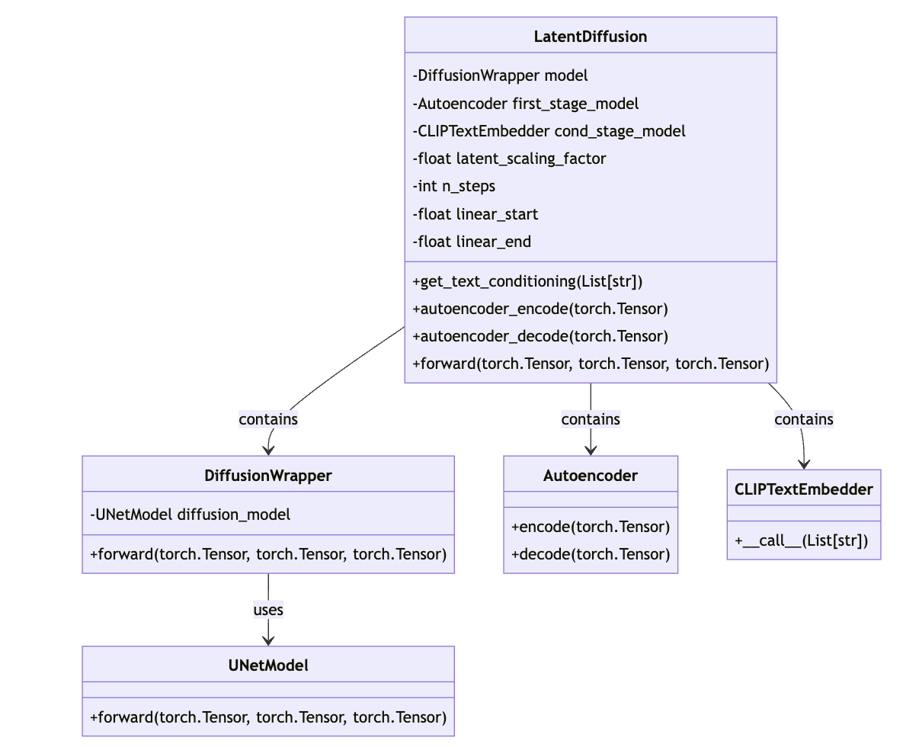
Putting it all together – LatentDiffusion Class
1. Diffusion:
Defines the Latent Diffusion model for text-to-image translation.
Integrates a DiffusionWrapper around the UNet model for processing.
Utilizes pre-trained Autoencoder and CLIP Embedder for conditioning.
Manages the diffusion process with customizable steps and scaling factors.
Handles image generation from latent space representations.

Slide 7
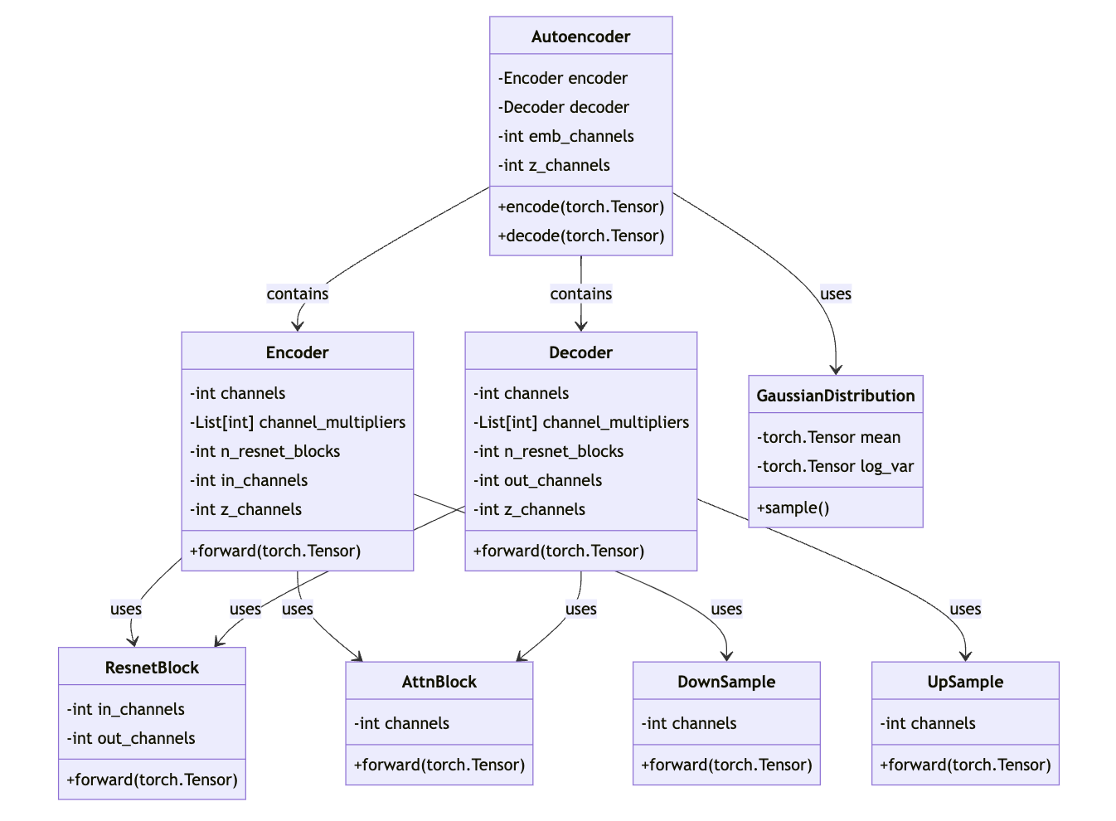
VAE ( Variational AutoEncoder )
2. Autoencoder (VAE):
Implements an encoder-decoder structure for image and latent space conversion.
Maps images to a lower-dimensional latent space and back.
Uses convolutional layers and normalization for efficient processing.
Applies quantization for discrete latent space representation.
Supports encoding and decoding functionalities for diffusion models.

Slide 8
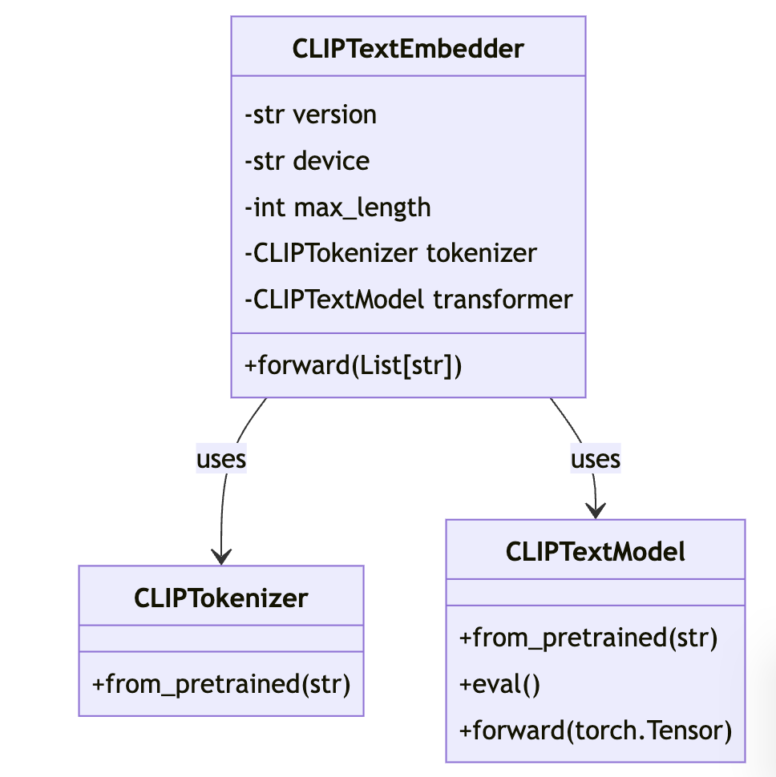
CLIP for Text Embeddings
3. CLIP:
Utilizes the CLIP model for converting text prompts into embeddings.
Leverages HuggingFace's Transformers library for embedding extraction.
Provides functionality to process multiple prompts in batches.
Converts text prompts into fixed-length vector embeddings.
Facilitates text-based conditioning for image generation tasks.

Slide 9
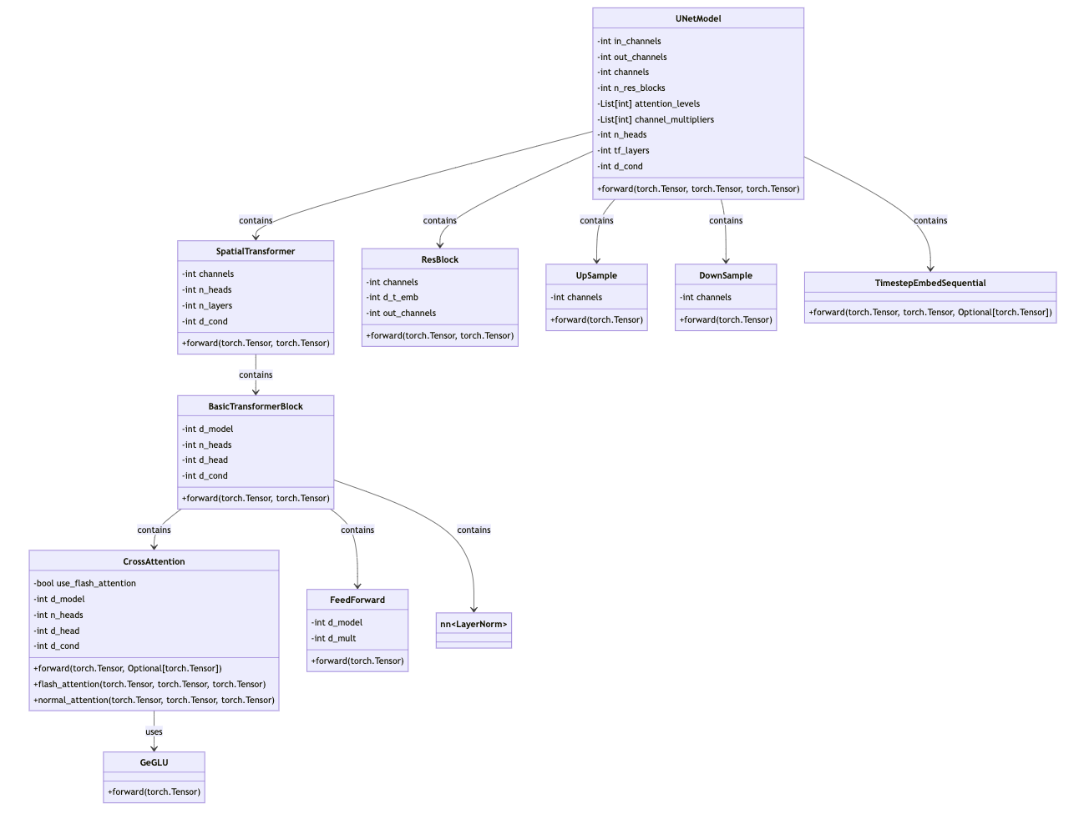
Unet Diffusion Wrapper Class
4. UNet:
Constructs a UNet architecture specifically designed for diffusion tasks.
Incorporates spatial transformers for attention-based feature refinement.
Manages multi-scale features through down-sampling and up-sampling layers.
Adapts to different resolutions and channels through configurable parameters.
Integrates time embedding and conditional guidance for detailed generation.

Slide 10
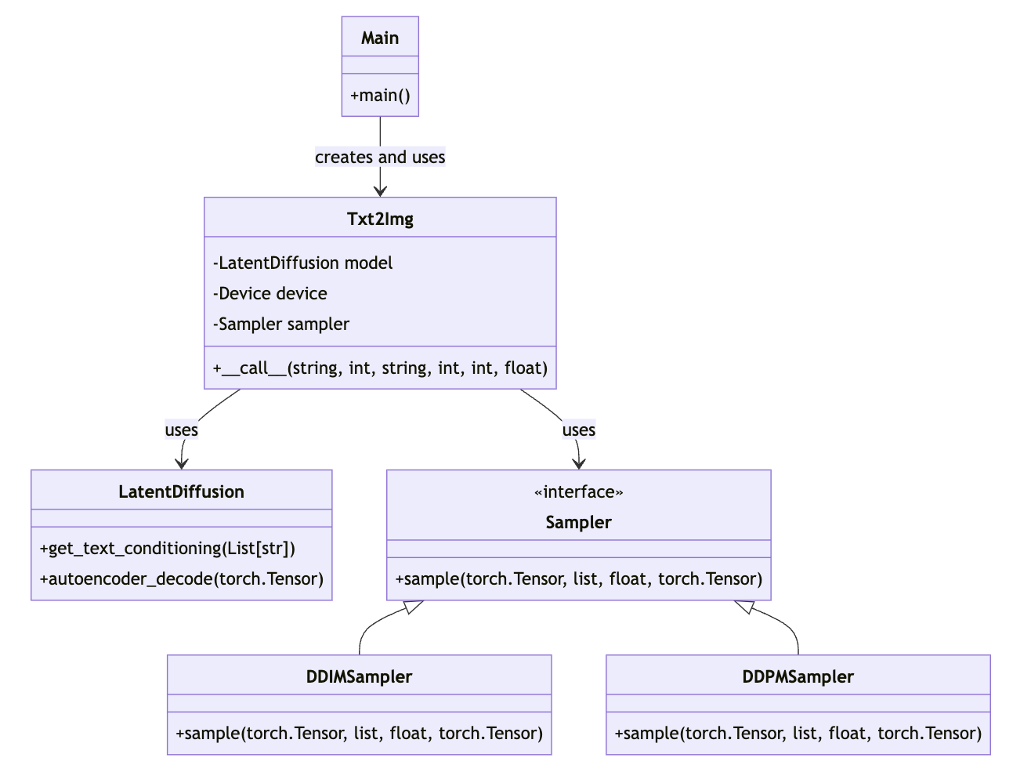
Prompt-to-image
5. Prompt to Image:
Initializes a text-to-image class, setting up model and sampling configurations.
Loads the Latent Diffusion model and sets the computational device.
Selects between different samplers (DDIM, DDPM) based on user input.
Generates images by conditioning on text prompts and managing batch processes.
Saves generated images to a specified directory after decoding from latent space.

Slide 11

References
https://arxiv.org/pdf/2112.10752.pdf - High-Resolution Image Synthesis with
Latent Diffusion Models
https://github.com/CompVis/latent-diffusion
https://towardsdatascience.com/you-cant-spell-diffusion-without-u-60635f569579
https://towardsdatascience.com/stable-diffusion-using-hugging-face-501d8dbdd8
https://openai.com/research/clip
https://sertiscorp.medium.com/latent-diffusion-models-a-review-part-i-d0feacc4906
https://github.com/labmlai/annotated_deep_learning_paper_implementations

